Slide 1

EIGEN VALUES
EIGEN VECTORS
and

Slide 2
Eigen values
If 𝐴 is a matrix 𝑛×𝑛, then a nonzero vector 𝒙 on ℝ𝑛 is called an eigenvector (characteristic vector) of 𝐴 if 𝐴𝒙 is a scalar multiple of 𝒙; explained:
𝐴𝒙=𝜆𝒙
for any scalar 𝜆.
This scalar 𝜆 is called the eigenvalue (characteristic value) of 𝐴, and
𝑥 is called the eigenvector (characteristic vector) of 𝐴 associated with 𝜆.

Slide 3
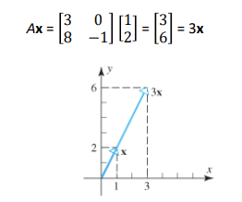
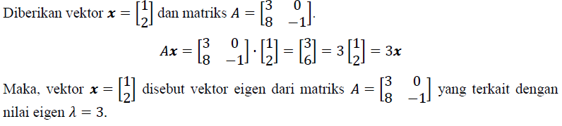
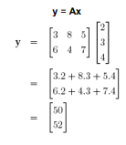

Eigenvalues
- example
+
+

Slide 4
Eigen values
To obtain the eigenvalues of a matrix 𝐴 of size 𝑛×𝑛, eq
𝐴𝒙=𝜆𝒙 can be rewritten as
𝐴𝒙=𝜆𝐼𝒙
𝐴𝒙−𝜆𝐼𝒙=𝟎
𝐴−𝜆𝐼 𝒙=𝟎
For 𝜆 to be an eigenvalue, there must be one nonzero solution to this equation. This equation has a nonzero solution if and only if
det 𝐴−𝜆𝐼 =0
The above equation is called the characteristic equation of the matrix 𝐴;
The scalars that satisfy this equation are the eigenvalues of the matrix 𝐴.
The characteristic equation above can also be written:
det 𝜆𝐼−𝐴 =0

Slide 5
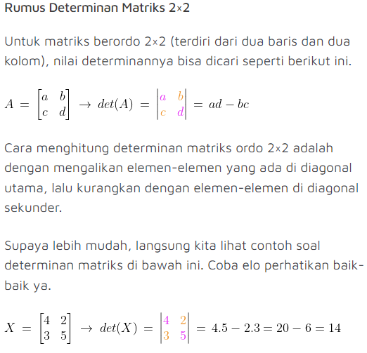

Matrix Determinant ordo 2x2

Slide 6
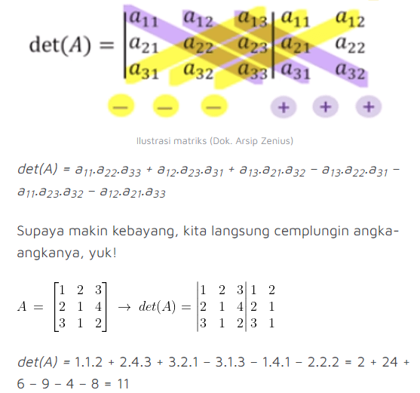
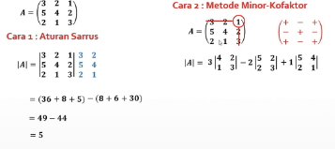
matrix Determinant 3x3
This uses the sarrus method, try calculating it using the cofactor method

Slide 7
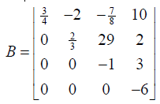
THEOREM 1
If 𝐴 is a triangular matrix (top/bottom) or diagonal matrix, then the eigenvalues of 𝐴 are the entries that lie on the main diagonal of matrix 𝐴.
Example:
Determine the eigenvalues of the matrix
Based on Theorem 1, the eigenvalues of matrix B
is 𝜆 = 3/4 , 𝜆 = 2/3 . 𝜆 = −1, 𝜆 = −6

Slide 8
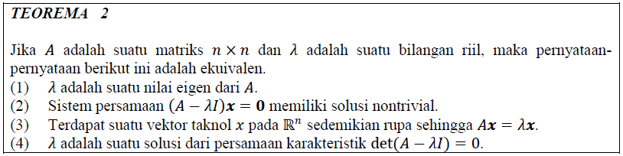

Slide 9
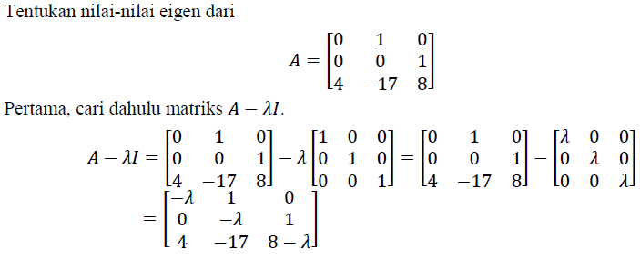
Eigenvalues
- example

Slide 10
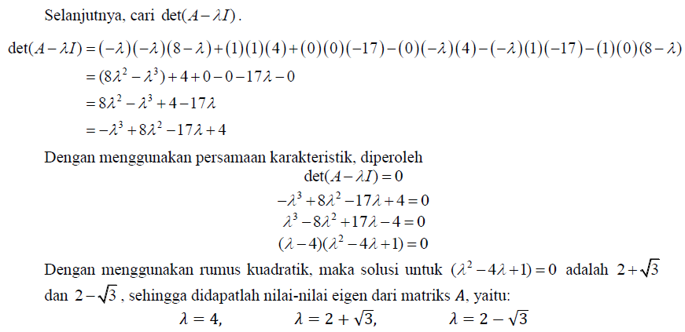
Eigenvalues
- Example

Slide 11
Eigenvectors
- Example
After knowing how to find eigenvalues, next is to learn how to find eigenvectors. The eigenvectors of the matrix 𝐴 associated with an eigenvalue 𝜆 are nonzero vectors 𝒙 that satisfy the equation
𝐴𝒙 = 𝜆𝒙
In other words, the eigenvectors associated with 𝜆 are vectors in the solution space 𝐴 − 𝜆𝐼 𝒙 = 𝟎. This solution space is called the eigenspace of the matrix 𝐴 which is related to 𝜆.

Slide 12

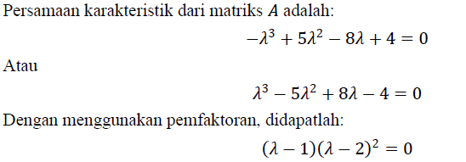
Eigenvectors
Determine the bases for the eigenspace of the matrix

Slide 13

Vektor Eigen
- Contoh
So, the eigenvalues of 𝐴 are:
𝜆 = 1 & 𝜆 = 2
Based on the definition,
is an eigenvector of the matrix 𝐴 associated with 𝜆 if and only if 𝐴𝒙 = 𝜆𝒙.

Slide 14
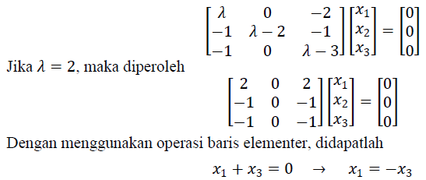
Vektor Eigen
- Contoh
This means that 𝒙 is said to be an eigenvector of the matrix 𝐴 if and only if 𝒙 is a nontrivial solution of the equation 𝐴 − 𝜆𝐼 𝒙 = 𝟎, namely:
Because from the results obtained, there is no information about 𝑥2, then 𝑥2 can be considered as a parameter; let's say 𝑥2 = 𝑡. And, let's also say that 𝑥3 = 𝑠, then: 𝑥1 = −𝑠, 𝑥2 = 𝑡, 𝑥3 = 𝑠
so, the eigenvectors of 𝐴 associated with 𝜆 = 2 are nonzero vectors of the form

Slide 15
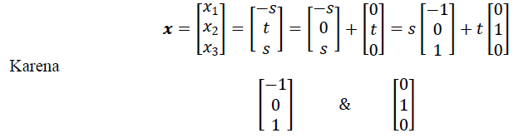

Vektor Eigen
- Contoh
linearly independent, these vectors form a basis for the eigenspace associated with 𝜆 = 2.
If 𝜆 = 1, then we get

Slide 16
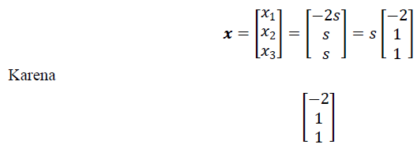
Vektor Eigen
- Contoh
By using elementary row operations, we get
𝑥1+ 2𝑥3 = 0 → 𝑥1 = −2𝑥3
𝑥2 − 𝑥3 = 0 → 𝑥2 = 𝑥3
Let 𝑥3 = 𝑠, then
𝑥1 = −2𝑠, 𝑥2 = 𝑠, 𝑥3 = 𝑠
so, the eigenvectors of 𝐴 associated with 𝜆 = 1 are nonzero vectors
shaped
Because they are linearly independent, the above vectors form a basis related to 𝜆 = 1.
To determine the eigenvectors corresponding to the eigenvalues (𝜆), you must
First determine the bases for the eigenspace.

Slide 17
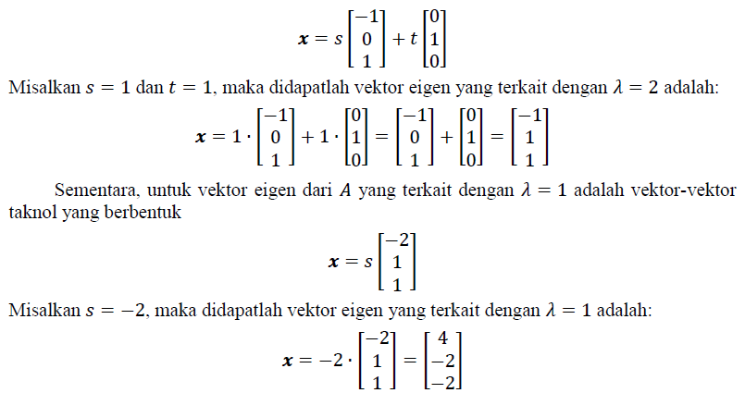
Vektor Eigen
Look again at the example above. For the eigenvector of 𝐴 associated with 𝜆 = 2
are nonzero vectors of the form

Slide 18

Eigenvectors
THEOREM 3
If 𝑘 is a positive integer, 𝜆 is the eigenvalue of a matrix 𝐴, and 𝒙 is the eigenvector associated with 𝜆, then 𝜆𝑘 is the eigenvalue of 𝐴𝑘 and 𝒙 is the eigenvector associated with it.
Contoh:
Pada contoh sebelumnya telah ditunjukkan bahwa nilai-nilai eigen dari matriks
adalah 𝜆 = 2 dan 𝜆 = 1, sehingga berdasarkan Teorema 3, nilai-nilai eigen dari matriks A⁷ adalah:
𝜆 = 2⁷ = 128 dan 𝜆 = 1⁷ = 1

Slide 19

Vektor Eigen
In addition, it has also been shown that the eigenvector of 𝐴 is related to 𝜆 = 2
are nonzero vectors of the form
Then, by Theorem 3, the eigenvectors of the matrix 𝐴 are related to
𝜆 = 2 will be equal to the eigenvectors of the matrix A7 associated with
𝜆 = 27 = 128. Likewise for 𝜆 = 17 = 1.

Slide 20

Vektor Eigen
It has been shown that the eigenvectors of 𝐴 associated with 𝜆 = 1 are nonzero vectors of the form
Then, by Theorem 3, the eigenvectors of the matrix 𝐴 are related to
𝜆 = 1 will be equal to the eigenvectors of matrix A7 associated with 𝜆=17=1.

Slide 21

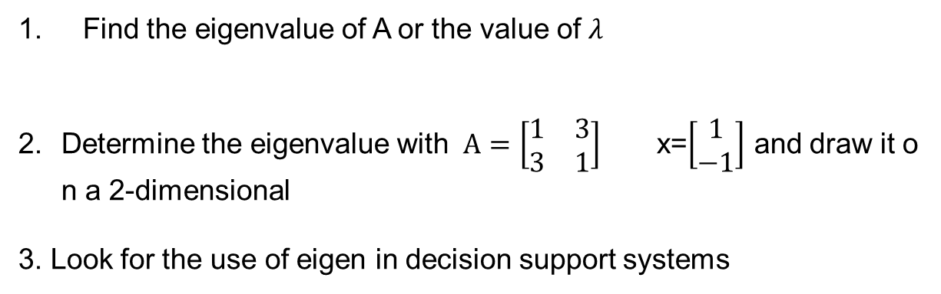
Exercises
Find the eigenvalue of A or the value of 𝜆
Determine the eigenvalue with $A=\left[\begin{matrix}1 & 3 \\ 3 & 1\end{matrix}\right]$ x=$\left[\begin{matrix}1 \\ −1\end{matrix}\right]$ and draw it on a 2-dimensional
3. Look for the use of eigen in decision support systems

